Slide 1
US Bank New Mobile App- Android Development Cognizant Proposal
November 2018

Slide 2
Table of Contents
1
EXECUTIVE SUMMARY, VALUE PROPOSITION
2
OUR UNDERSTANDING OF SCOPE, SOLUTION
3
IMPLEMENTATION APPROACH, TIMELINES
4
OUR CAPABILITIES & EXPERIENCE

Slide 3




Executive summary
US Bank is in the midst of a Digital transformation journey to enhance its Customer experience and Digital footprint through introduction of new products, services and platforms. As part of the initiative, US Bank is planning to build a new Android application, similar to the new iOS based Banking application that is currently being developed. The new Android application will enable US Bank’s customers to perform all banking operations including Account management, Money transfer, Service requests …
OUR PROPOSITION
SOLUTION
ENGAGEMENT APPROACH
TIMELINE
Develop Native Android Application retaining the new mobile user experience with optimized Android native experience
Reusable testing framework
SeeTest Tool based Automation Testing
Access to Fastest Mobile testing Lab
Fortify based security testing
Distributed Agile, leveraging Onsite/Offshore Model
Best-in-class Subject Matter Experts planned for the engagement,
Leveraging Cognizant’s Mobile testing labs and frameworks for extensive testing coverage besides using reusable components for faster execution.
Continued involvement of the Mobility Practice and Engagement Leaders throughout the lifecycle of the project
Cognizant proposes a 25 weeks plan in agile mode of delivery targeting Go live by May 2019 followed by 4 weeks of Warranty support
8 Sprints, split into 2 Waves
Completely customized POD based approach tailored for US Bank’s needs
4 Android ‘Development’ PODs
1 Core POD
1 Support POD
OUR EXPERTISE
& EXPERIENCE
Established footprint in US Bank with excellent delivery track record
Experience in building High Quality, Industry leading, Highly rated Mobile applications, similar to US Bank’s needs
Dedicated Mobile competency with 1500+ Developers and has implemented 1200+ Projects across the globe
Dedicated QA competency with 4000 Mobile QA Experts and services 600+ Clients

Slide 4




Cognizant’s Value Proposition
The program will be overseen by a Enterprise Mobility Strategist with proven experience in similar programs
Cognizant will bring in a Seasoned Team of Experts with strong Android experience in executing similar programs as Anchor team on Day-1
The program will be supported by Cognizant Digital practice, bringing in our collective Digital experience from serving Digital leaders
UNMATCHED EXPERTISE and EXPERIENCE
COGNIZANT
VALUE ADDS &
INVESTMENTS
Cognizant will provide US Bank access to FASTEST - Cognizant Mobile testing lab to accelerate testing of this engagement
Cognizant will build Reusable Component Repository to be used for future releases
Cognizant investments in the program through
An upfront discount on the Total price and
Leveraging Credits from Cognizant Innovation Fund for US Bank
SIMPLIFIED
ENGAGEMENT & PRICING
MODELS
Cognizant is open to the following pricing models, in addition to traditional T&M based Model
Fixed price for the entire engagement
A Flat Fee per-month for the PODs
Cognizant is open to start a new Delivery Center in Minneapolis for US Bank in 2019 for the engagement, should US Bank prefer

Slide 5



Our Understanding of Scope
SCOPE
Requirement Gathering & Sprint Planning
Native Android Mobile development
UX Wireframe and Visual Design (Align iOS Design for Android)
Automated Unit Testing using CI/ CD
Functional Testing
Accessibility Testing - WCAG 2.0 Level AA
Static & Dynamic application security testing
Performance Testing
BLAT Support
Go-Live and Warranty support
Functional Scope
Hello
Standard Authentication
Touch ID/Face ID
Custom Dashboard (DDA/Savings)
Step-up (OTP)
Quick Navigation Menu
Login Assistant
Step-up (Visual Pattern)
Cash flow visualization
Insights on Dashboard
Dashboard
Digital Enrollment
Account Overview: RPS, Mortgage, Wealth, Loans & Lines and Leases
Total assets/liabilities card on feed for wealth customer only
First time Download Tutorial
Account Management
Account Dashboard & Details
Transaction List
Transaction Details
Search/Sort/Filter
Account Dashboard & Details
Link to Mortgage servicing, Brokerage or Trust Servicing
Card Control(ON,OFF, Travel, Activation, PIN, Wallet, GEO)
View checks
Language Preferences
Projected Balance
Lock/Unlock (credit)
Small Biz account
Wealth SSO
Trust/Brokerage/Mortgage SSO exceptions
Profile changes
Spanish Language
Insights
Initial Insights library: Travel, Cashflow, Save, Debt etc.
Offers & Messaging
Permissions/Data Privacy
Delivery: In app
Hassle free action on Insight
Feedback & Optimization
CCD Pmt Past Due
Card activation
eStatement Adoption
CCD expiration
Touch/Face ID adoption
Small Biz application status
HELOC Refi
HELOC Usage
Projected Balance
MTG Application Status
CCD Balance Transfer
CCD Rewards Promotion
OUT OF SCOPE
Development of Web services/Middleware and any change in API’s/Backend services & Performance Optimization of Backend services
Server Configuration & server side troubleshooting
Language support other than English and Spanish
Accessibility validation of 3rd party/external websites/domains such as Facebook/Twitter/LinkedIn pages
Prototyping
Offline support
Analytics tag manager set up
App store deployment
Infra set up and Configuration
Money movement
Zelle in Context
Send money - Future dated payment for money movement
Bill Pay/Payment confirmation
Internal A2A transfer
Mobile check Deposit
Bill payment scope
Grow
Market Place of products
Consumer check in
Consumer Credit cards plus Dynamic Smart apply
Mortgage Purchase- Blend
DDA onboarding
DDA Funding
Fix DDA Pre fill
Mortgage Purchase
Mortgage refinance
Simple Loan
Small Business lending
Consumer savings
Help me
Help, Contact info, FAQ
Branch Locator
Appointment scheduling
Push Notification
In Context help - Zelle & MCD
Statement request
Alerts management
Foresee
Help & Contact us via sign on
Contact us (wealth, MTG, CCD)
Contact us updates (wealth, credit card, Mortgage)
Co-browse

Slide 6

Key Solution Tenets
KEY SOLUTION HIGHLIGHTS
Application Design & Architecture
Integration
Native UI will be developed to provide rich user experience
The application will be built as Universal App as a single app instance that runs on both smartphone & tablets enabling option for code reuse
Flexible and layered architecture enabling seamless and easier integration with the systems in future
App design to optimize device battery & Network usage
The app will consume data over HTTPs channel and will hide/ obscure app sensitive data
Accessibility Compliance of WCAG 2.0 Level AA using Talkback or Voice Assistant screen reader
The mobile app will communicate with the backend system through JSON based REST Web Services
Analytics, Crashlytics, Push Notification, etc. to be integrated with Adobe Campaign
Biometric Authentication
Transmit Security will be used for Fingerprint Authentication
Authentication token will be used to get app data
Automation testing
Performance testing
Security testing
Seetest Automation tool (licensed, partnered with cognizant) will be used for Test automation
Execute automation scripts by leveraging unified framework (Next Gen CRAFT) along with automation tool
Android Profiler & LoadRunner will be leveraged for Performance testing
Proposes to leverage Fortify tool for Security testing
*Kindly refer to Appendix on the Testing approach and toolsets proposed

Slide 7

Proposed Solution Architecture
Android Device
US Bank Infrastructure
Business Service Layer
PRESENTATION LAYER
UTILITY
1
Login
Touch ID
Hello
Account
Management
Login
Settings
Logger
Registration
Preferences
Anticipate
Money Movement
Grow My
Relationships
Help Me
Reachability
ESB
User Profile
2
BUSINESS LOGIC
Analytics
Hello
Account Management
Application Façade (Optional)
Anticipate
Money Movement
Navigations
Components
Entities
Crashlytics
Help Me
Grow My Relationship
Custom Process
Push
Notification
HTTPs
JSON
Backend Systems
DATA ACCESS
Service
Adapters
Database
Connectors
Data Helper
Transmit
Security
Service Agents
JSON Parser
Calendar
NATIVE SDK
NATIVE RUNTIME
ESB
Authentication/Authorization
Database
3
Mobile App: Native Development Approach
Server Components:
US Bank Services (existing)
Custom Services (existing)
Third Party Components for Push Notification, Analytics, Crashlytics etc.
External Systems
Analytics
Transmit Security
Crashlytics
Push Notifications
Notes:
VDIRP
There are a lot of different ways to make mobile apps today. Going to help to educate you on the space and explain when our model starts to become attractive for many companies.
[transition – so what do we do?]

Slide 8

Implementation Approach - Agile POD Structure
Cognizant proposes to execute the engagement leveraging an Agile POD based structure:
4 Android PODs
1 Core POD consisting of Architects & Leads
1 Support POD- for Shared Functions- Performance/ Security Testing, UX, etc
Core POD
Android Lead Architect
Product Manager
Android Architect
Scrum Master
Scrum
Coordinator
QA Lead
Support POD
Accessibility Consultant
Performance Tester
Security Testing
UX Designer
Visual Designer
POD 1
POD 2
POD 3
POD 4
Android Lead
Android Lead
Android Lead
Android Lead
Android Developer
Android Developer
Android Developer
Android Developer
Android Developer
Android Developer
Android Developer
Android Developer
Android Developer
Android Developer
Android Developer
Android Developer
Automation Tester
Automation Tester
Automation Tester
Automation Tester
Automation Tester
Automation Tester
Automation Tester
Automation Tester
QE Tester
QE Tester
QE Tester
QE Tester
Android POD 1
Android POD 2
Android POD 3
Android POD 4
Onsite
Offshore
Notes:
VDIRP
There are a lot of different ways to make mobile apps today. Going to help to educate you on the space and explain when our model starts to become attractive for many companies.
[transition – so what do we do?]

Slide 9
Proposed POD Wise Deliverables*
POD 1
POD 2
POD 3
POD 4
Hello
Account Management
Account Management
Help Me
Touch ID/Face ID
Custom Dashboard (DDA/Savings)
Step-up (OTP)
Quick Navigation Menu
Login Assistant
Step-up (Visual Pattern)
Cash flow visualization
Insights on Dashboard
Dashboard
Digital Enrollment
Account Overview: RPS, Mortgage, Wealth, Loans & Lines and Leases
Total assets/liabilities card on feed for wealth customer only
First time Download Tutorial
Account Dashboard & Details
Transaction List
Transaction Details
Search/Sort/Filter
Account Dashboard & Details
Link to Mortgage servicing, Brokerage or Trust Servicing
Card Control(ON,OFF, Travel, Activation, PIN, Wallet, GEO)
View checks
Language Preferences
Projected Balance
Lock/Unlock (credit)
Small Biz account
Wealth SSO
Trust/Brokerage/Mortgage SSO exceptions
Profile changes
Spanish Language
Help, Contact info, FAQ
Branch Locator
Appointment scheduling
Push Notification
In Context help - Zelle & MCD
Statement request
Alerts management
Foresee
Help & Contact us via sign on
Contact us (wealth, MTG, CCD)
Contact us updates (wealth, credit card, Mortgage)
Co-browse
Wave 1
Sprint 1-4
Help Me
Contact us (wealth, MTG, CCD)
Contact us updates (wealth, credit card, Mortgage)
Co-browse
Money Movement
Insights
Insights
Grow
Initial Insights library: Travel, Cashflow, Save, Debt etc.
Offers & Messaging
Permissions/Data Privacy
Delivery: In app
Hassle free action on Insight
Feedback & Optimization
CCD Pmt Past Due
Card activation
eStatement Adoption
CCD expiration
Touch/Face ID adoption
Small Biz application status
HELOC Refi
HELOC Usage
Projected Balance
MTG Application Status
CCD Balance Transfer
CCD Rewards Promotion
Market Place of products
Consumer check in
Consumer Credit cards plus Dynamic Smart apply
Mortgage Purchase- Blend
DDA onboarding
DDA Funding
Fix DDA Pre fill
Mortgage Purchase
Mortgage refinance
Wave 2
Zelle in Context
Send money - Future dated payment for money movement
Bill Pay/Payment confirmation
Internal A2A transfer
Mobile check Deposit
Bill payment scope
Sprint 5-8
Grow
Simple Loan
Small Business lending
Consumer savings
*Proposed deliverables are tentative and will be mutually agreed between Cognizant and US bank during Sprint planning

Slide 10
Proposed Implementation Plan
W1 | W2 |  | W3 | W4 |  | W5 | W6 | W7 | W8 | W9 | W10 | W11 | W12 | W13 | W14 | W15 | W16 | W17 | W18 | W19 | W20 | W21 | W22 | W23 | W24 | W25 | W26 | W27 | W28 | W29
Sprint 0 <Design>
 | Wireframe & Visual Design
 |  |  | Sprint 1- 4 <Development & Testing>
POD 1 |  |  | Hello
POD 2 |  |  | Account Management
POD 3 |  |  | Account Management & Help me
POD 4 |  |  | Help me
 |  |  |  |  |  |  |  |  |  |  |  | Hardening Sprint
 |  |  |  |  |  |  |  |  | Support POD |  |  | Performance Testing
 |  |  |  |  |  |  |  |  | Support POD |  |  | Security Testing
 |  |  |  |  |  |  |  |  |  |  |  |  |  | Sprint 5- 8 <Development & Testing>
 |  |  |  |  |  |  |  |  |  |  |  | POD 1 |  | Money Movement
 |  |  |  |  |  |  |  |  |  |  |  | POD 2 |  | Insights
 |  |  |  |  |  |  |  |  |  |  |  | POD 3 |  | Insights & Grow
 |  |  |  |  |  |  |  |  |  |  |  | POD 4 |  | Grow
 |  |  |  |  |  |  |  |  |  |  |  |  |  |  |  |  |  |  |  |  |  | Hardening/ BLAT1 |  | BLAT 2
 |  |  |  |  |  |  |  |  |  |  |  |  |  |  |  |  | Support POD |  |  | Performance Testing
 |  |  |  |  |  |  |  |  |  |  |  |  |  |  |  |  | Support POD |  |  | Security Testing
 |  |  |  |  |  |  |  |  |  |  |  |  |  |  |  |  |  |  |  |  |  |  |  |  |  | Go live
 |  |  |  |  |  |  |  |  |  |  |  |  |  |  |  |  |  |  |  |  |  |  |  |  |  |  | Warranty
Planned Go- Live in May 2019
8 sprints, split into 2 Waves
Concurrent execution of 4 sprints
Executed through 4 PODS + 2 Shared PODs
25 weeks duration+ 4 weeks of Warranty support
Wave 1
Wave 2

Slide 11
Key Assumptions
Scope Assumptions:
Target platform considered is for Android covering Android Phone & Tablet devices running Android OS 6.0,7.0 & 8.0
Current assumption is considered for 5 user group. If more user groups are added to this application/ portal at a later point of time, the effort would increase proportionally.
Overall 25 business critical flows has been considered for which performance test script needs to be developed
We assume tutorial feature in Hello Module will have static screens that needs to be rendered as an overlay on top of application's first screen/first time login
We assume The 'Digital Enrollment' feature is available on web and not considered in scope for mobile app
Insights features assumed to be integration with external API and cognizant has assumed 4 to 5 screens on an average for this module. Estimation shall be revised after requirement is finalized
Set up Visual pattern & Password reset are not considered in the scope
Link to Montage is assumed to be URL redirect from the app
For Wealth/Mortgage features , we have assumed 5 screens per menu & redirect to Application wherever required
General Assumptions:
Estimation is based on our understanding of high level features/ requirement shared by US Bank. Any change in scope & complexity will impact the timeline and efforts
Only English & Spanish language support are considered
Design Assumptions:
Wireframes and Visual Designs will be created only for Typical screens & Component Interaction or Layout changes for Android only. Orientation support considered is Portrait for Phone and Landscape for Tablet
Accessibility evaluation would be conducted with TalkBack or Voice Assistant screen reader in Android
Level AA Accessibility compliance is considered.
We assume existing User experience to be migrated to Android. Enhancement is not expected. iOS design documents (authorable files) will be provided
Any changes in the design after the wireframes are signed off will be considered as a change request and might impact the efforts /timeline
QA Assumptions:
We assume 1 cycle of SIT Test Execution followed by defect retesting
100% End to End Functional and Regression testing would be performed on Primary devices
40% and 20% compatibility testing would be conducted on Secondary devices and tertiary devices Testing to be done on the devices mentioned in the device matrix
Device Matrix
DEVICE NAME & VERSION | OS VERSIONS | COVERAGE
Galaxy S7 | Android 9.0 | 20%
Galaxy S8 | Android 8.0 | 20%
Galaxy S8 Plus | Android 9.0 | 20%
Galaxy S6 | Android 7.0 | 10%
Galaxy S7 Edge | Android 6.0 | 5%
Galaxy Note 5 | Android 8.0 | 5%
Galaxy S5 | Android 7.0 | 5%
Galaxy Note 8 | Android 6.0 | 5%
Galaxy J7 | Android 7.0 | 5%
Motorola Moto | Android 6.0 | 5%

Slide 12
Key Dependencies
Environments (DEV, SIT & UAT) should be ready with the required software installed and configured. Access and authorization to all relevant environments must be enabled for project teams
Ux Wireframe & Visual Design and style guides should be provided by the client at the start of the Sprint development. Provided Designs should be accessibility compliant
All media/Design artifacts, such as logos, banners, images, videos, icons, color schemes/codes, custom fonts, brand guide, etc. will be provided by US Bank
All required Web services should be provided by US Bank in REST-JSON format. US Bank will supply mock services while the backend services are being developed
Content for Spanish language shall be provided by US Bank
Automation tool Workstation, connectivity and Physical Devices to be provided by customer
All necessary test data and test environment shall be made available by US Bank It is assumed that the provided test data is error free
All required tools/licenses, and tool-hosting infrastructure shall be made available
Access to the performance-test environment (Mobile/App/DB servers) shall be provided to monitor server-health during the test executions. If such access is not available, relevant US Bank team will monitor servers during execution and share the logs with the performance assessment team.
Performance SLAs for key business transactions will be provided by US Bank
Approval and Sign-off on deliverables needs to be provided by US Bank before start of the subsequent project phases
Necessary infra support during off business hour(IST business hours) during performance test execution period
CI/CD set up shall be made available before start of development
US Bank to provide licenses for all the required platforms:
SeeTest
Loadrunner

Slide 13
Our Capabilities & Experience

Slide 14






Cognizant Digital Business – Capabilities Snapshot
GLOBAL TALENT
EXPERIENCE SUMMARY
OUR RECENT ACQUISITIONS
1000⁺
Strategists, Researchers
& Designers
3000⁺
Creative Technologists
5000⁺
Mobile and Full stack developers
1500⁺
Mobile Apps delivered
Worlds most advanced human science consultancy
7 out of top 10 Insurers in the US
PRINCIPAL CREATIVE STUDIOS
Strategic innovation and experience design firm
TOR
LON
AMS
CHN
NYC
PHL
Digital technology project delivery methodology
OUR SERVICE OFFERINGS
Digital Marketing Agency (Phil, LA, London)
Consulting Services
Industry & Markets
Products
40+ Homegrown solutions
Services & Operations
Amsterdam based Digital Agency
COGNIZANT IN THE MEDIA
230
Fortune 500
529
Forbes Global 2000
281
Financial Times 500
96
Forbes’ World’s Most Innovative Companies
93
Newsweek’s Global Green Ranking
7Years in a row
Fortune’s Most Admired Companies
Leader recognition in Forrester’s Enterprise Mobility Wave

Slide 15

Our Digital, Design and Interactive Capabilities….
250+
TOP-TIER CLIENTS
Financial Services
Manufacturing
Media & Tech
Insurance
Retail & Hospitality
Healthcare
Life Sciences
Government
Strong global talent pool designing world class User Experience solutions across technology platforms & devices.
We are one of the largest Design Services groups in the industry, helping our clients create end-to-end value throughout the customer lifecycle and to deliver a Data-driven, Multi-screen Digital Experiences.
3500+
DESIGN ASSOCIATES
HIGHLIGHTS
One-stop-shop for integrated Experience Strategy, UX Design and UI Development
Large pool of Design Experts with over 15 years of global industry experience
Application of design experience & best practices from different domains
Experience across range of front-end technologies and devices
Last mile design support to IT teams
400+
600+
5000+
DIGITAL CONSULTANTS
Digital Experience Strategists
UX Analysts/Researchers
Information Architects
Interaction Designers
Creative Directors
Mobility UX Designers
CREATIVE DESIGNERS
Interaction Designers
Mobile UX Designers
Art Directors
Visual Designers
Flash Designers
Production Artists
Print Designers
UI ARCHITECTS & DEVELOPERS
Front-end architects
Front-end Developers
HTML 5, CSS, jQuery, YUI experts
Flex/Flash/Scripting Programmers
Accessibility experts
Global Delivery Centers: India, USA, Canada, UK, Europe, Argentina, Brazil, China
15

Slide 16
Experience Design Partner for Global Brands
Design Partner for World’s Largest Online and Mobile Payment Processor
Design Partner for World’s Largest Non-profit Financial Institution
Design Partner for World’s largest Credit Card Issuer
UX Design Partner since 2016, with an ongoing engagement of 35+ member strong team of User Experience Designers to support client’s global UED Team across 2 major market facing product streams.
Cognizant’s design team works in a 3-in-a-box model by partnering with Product Management, User Experience Design & Product Engineering groups.
Cognizant has been a global design partner for UXM group at the bank since 2010.
User Experience Management (UXM) team at the bank helps transform the way bank develops solutions, processes, and strategy by bringing together what is desirable from a human point of view with what is technologically feasible and economically viable in order to optimize investments.
Leading global design partner since 2010.
Successfully running UX design engagements for business lines including Consumer cards, Small Business Cards, International Cards across 21 markets while supporting technology innovation in Responsive Web Design, Augmented Reality experience, Native Apps and Hybrid Apps.

Slide 17
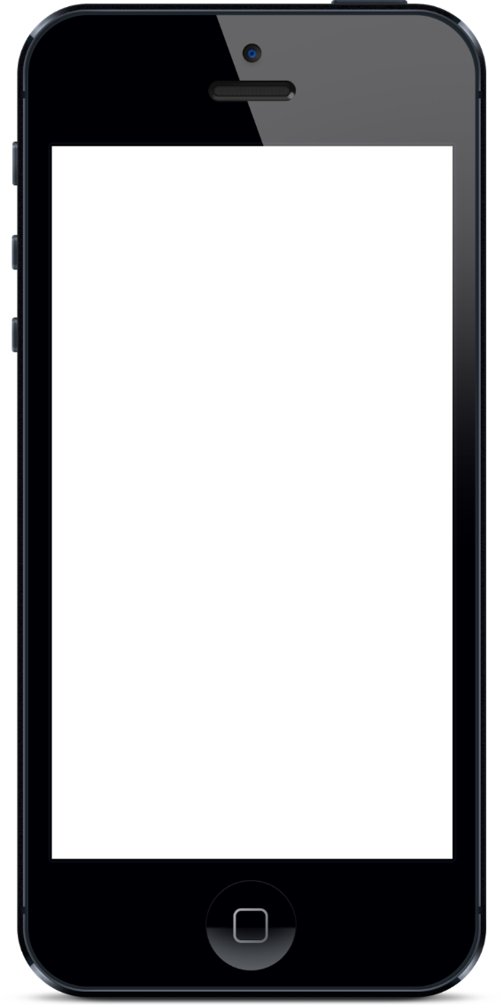
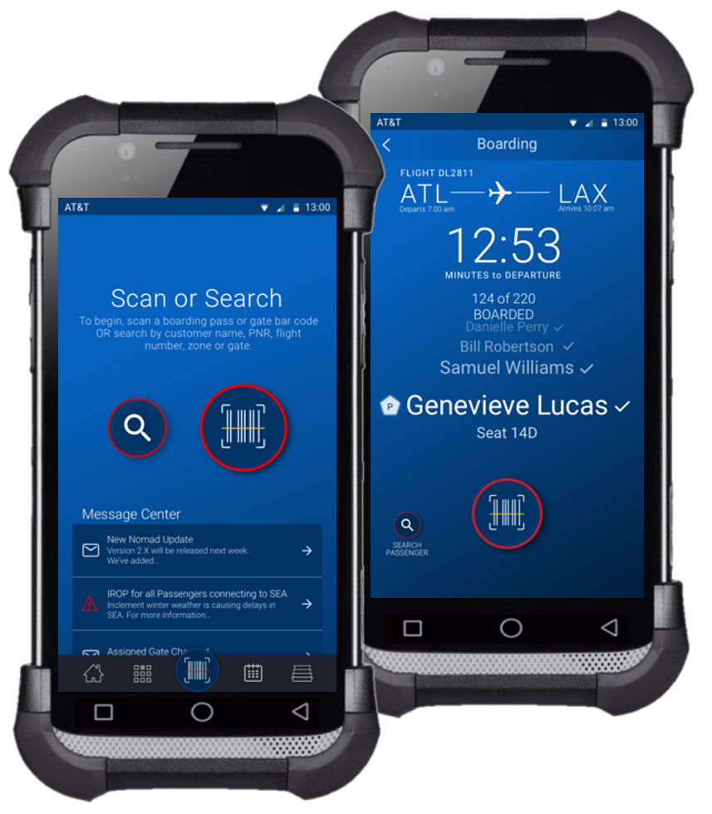
Reimagining airport customer experience
A Leading airline based out of the US
THE STORY
The client wanted to completely rethink their customer experience in the airport by taking advantage of mobile and other digital technologies. The objective was to completely reimagine the airport customer experience by merging the needs of the business with the desires and behaviors of users.
WE DELIVERED
This initiative was a first step for Cognizant to successfully engage the business team and IT in future state goal of full user mobility. This project helped in winning over the confidence of a new leadership team and built a solid relationship with the business. The solution began with kicking off a user-centered design approach, making greater automation and quick access to information a reality. It simplified the process of engaging stakeholders, which will lead to the release of the MVP application in the next year.

Slide 18
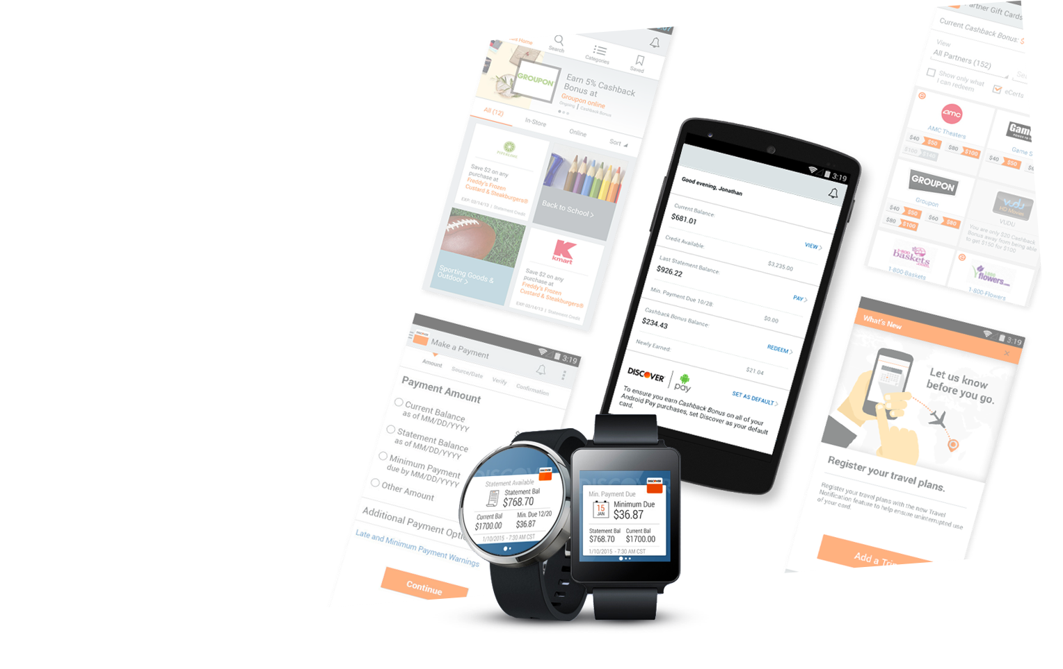

Mobile First Development - Bank & Cards - RWD & Mobile App
A Leading Financial & Cards Provider
Enhanced experience across Digital channel –mobile/tablet web sites, native as well as responsive sites to maintain the balance between the simplicity and innovation
65%
Research
Insight
Vision
Concept
Build
Customer Acquisition
Mobile Banking (mBanking): Balance inquiries, transaction history, intra-account funds transfer and bill pay
Mobile Payments (mPayments): Purchase of goods or services remotely via remittance or at the POS
Mobile Marketing (mMarketing): Advertising, location-based promotions, loyalty and rewards
40%
Increase in Downloads on Day 1
1,000,000 +
Downloads

Slide 19
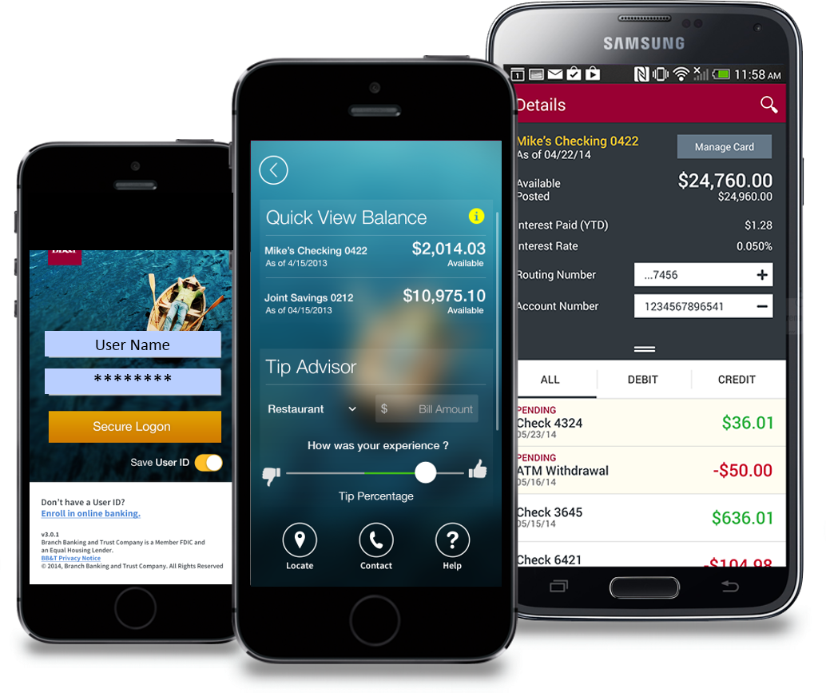
Mobile Banking Services App
A Leading Bank based out of the US
Provide a unified mobile Banking self-servicing platform across iOS & Android focused on convenience and exemplary customer experience.
Research
Insight
Vision
Concept
Build
4.8*
Rating increase in app store from 1.5*
Mobile banking services for the banking clients to provide access for all the next gen features like Deposit check, Biometric authentication, Quick view balance & certificate pinning
82%
Of Registered users have provided a 4*+ rating in the app store
700,000 +
Downloads
Registered users across iOS & Android

Slide 20
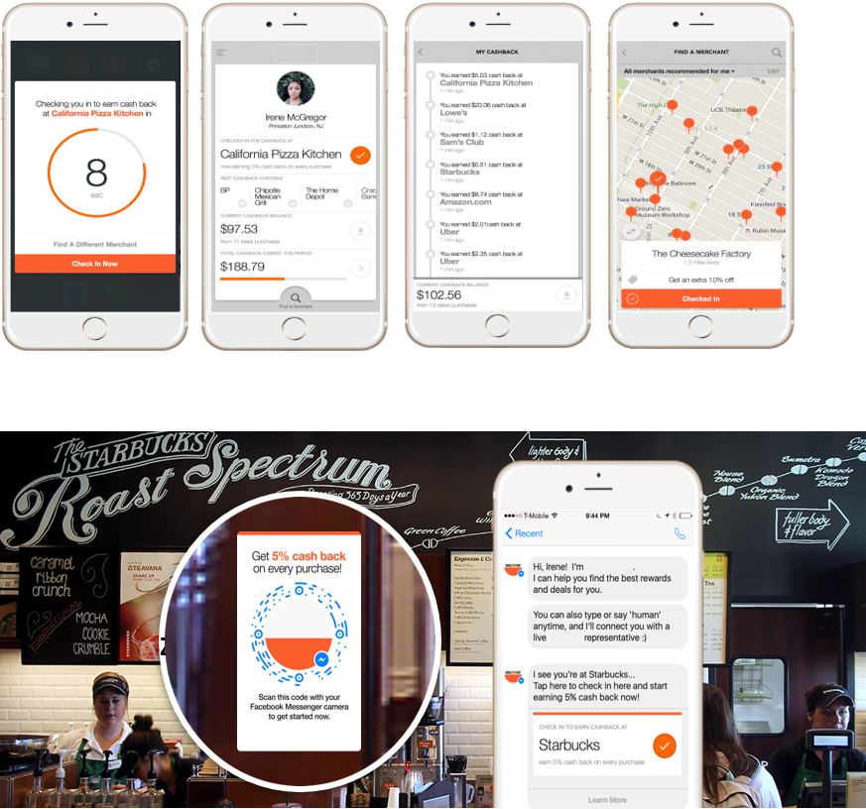
Shaping future of flagship cash back rewards program
A Leading card Provider
The customer partnered with us to help shape the future of their flagship 5% cash back rewards program.
We crafted a strategic vision and a suite of concepts that inspired change and broader innovation by testing the boundaries of the customer’s business model, customer experience strategy, and technical infrastructure. We took the customer on a journey way outside of the box and delivered something truly unexpected and aspirational
“Zero click”
the first rewards app to inspire the customer to push the boundaries
Research
Insight
Vision
Concept
Build
Location Based Merchant offer
New possibilities to inspire their social platform strategy through ideas for Facebook Messenger, WhatsApp, and Telegram.
Downloads

Slide 21
Thank You

